Slide 1
CASE STUDY
DECISION MAKING FOR BANK LOANS

Slide 2
Analysis of New Applications
The analysis that are presented in the following slides is based on the data of new applications that have poured in for the loans and the inferences are drawn based on the plots of the same.
There are multiple stages of analysis namely univariate , bivariate and which this document would take you through by providing meaningful insights regarding what the plots are all about.
The inference numbering has been done based on the python notebook

Slide 3
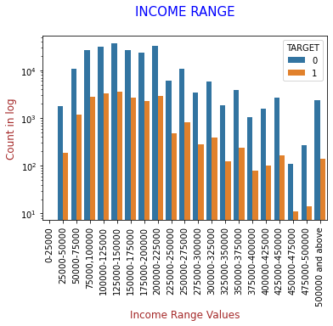
Univariate analysis of Application dataset
Inference 1.1
From the above plot we can infer that the maximum number of clients without payment difficulties lie in the income range 1.2lac-1.5lac and immediate next income range is 2lac-.25 lac.
Most clients with payment difficulties lie in the income range is 4.5lac-4.75lac

Slide 4
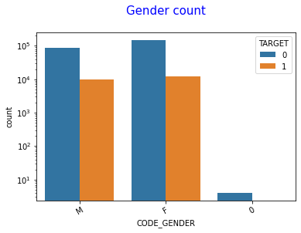
Inference 1.2
It can be seen that both number of males and females is same for having payment difficulties
It can also be seen that number of females is more than males for not having payment difficulties

Slide 5
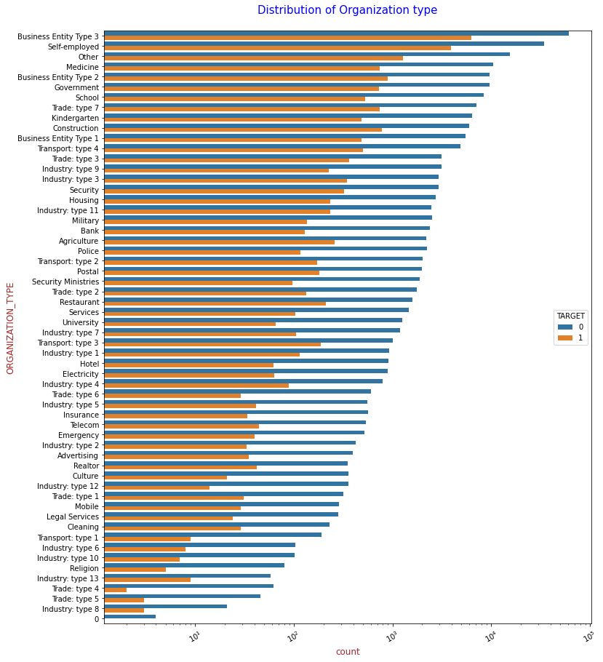
Inference 1.4
It can be seen that Trade: type 4, organisation type have least count of payment difficulty clients.
Most clients with no payment difficulties lie in organisation type named Business Entity Type 3.

Slide 6
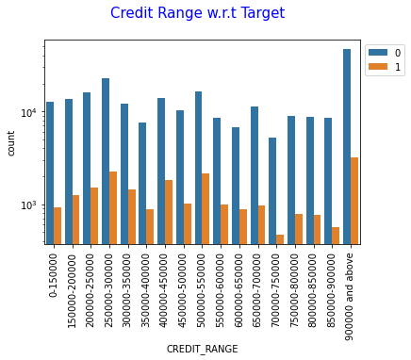
Inference 1.6
Clients with credit range lying in 900000 and above are the ones who are capable of paying the loans back
Least number of clients lying in income range 7lac- 7.5 lac are not capable of paying

Slide 7
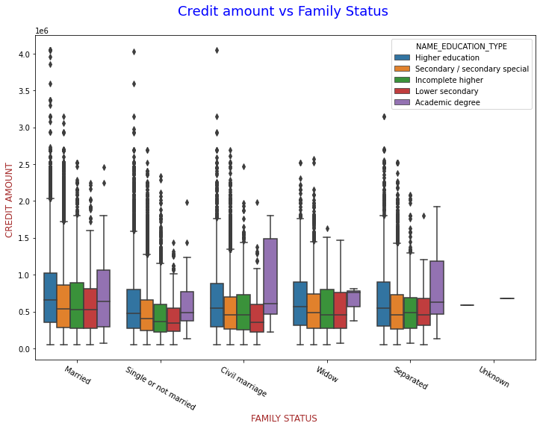
Bivariate Analysis of Application dataset
Inference 1.7
Family status of 'civil marriage', 'marriage' and 'separated' of Academic degree education are having higher number of credits than others.
Also, higher education of family status of 'marriage', 'single or not' and 'civil marriage' are having more outliers. Civil marriage for Academic degree is having most of the credits in the third quartile.

Slide 8
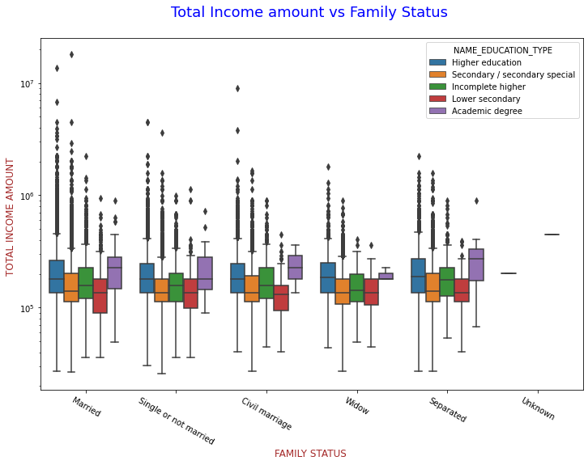
Inference 1.8
Family status of 'civil marriage', 'marriage' and 'separated' of Higher education are having higher number of income than others.
Also, higher education and secondary/second special education statuses with family status of 'marriage', 'single or not' and 'civil marriage' are having more outliers. Married for Higher education is having most of the incomes in the lower bound.

Slide 9
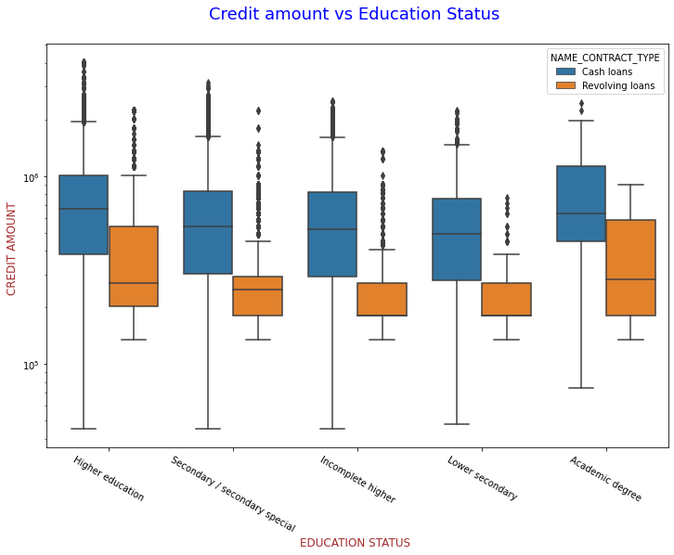
Inference 1.9
Education status of higher education and secondary/secondary special have most clients for contract type cash loans
Most number of clients applying for revolving loans are in education status Academic degree and higher education

Slide 10
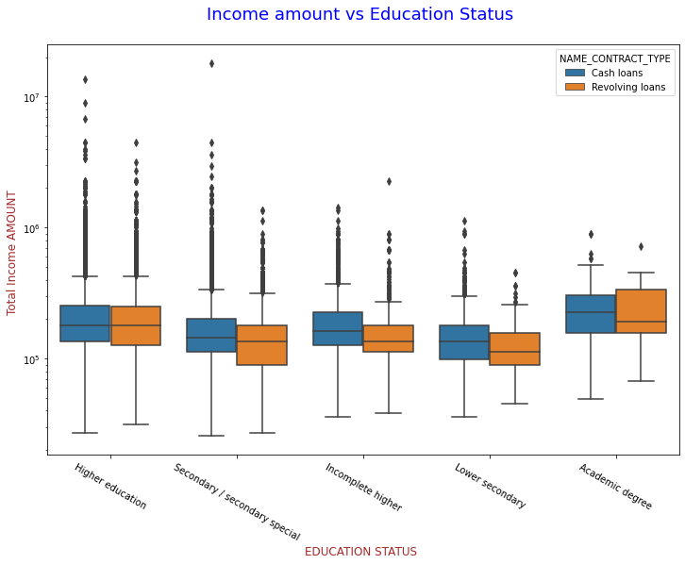
Inference 1.10
It can be seen that the clients with education status of Higher education are the maximum credit seekers with highest in terms of contract type of cash loans of contract type
It can also be observed that the contract type revolving loans issued maximum credit amount holders education status Higher education
The hightest credit amount in cash loans is given to a client with education level secondary/secondary special
Basically education level or type is not playing much role as of who gets what amount of credit

Slide 11
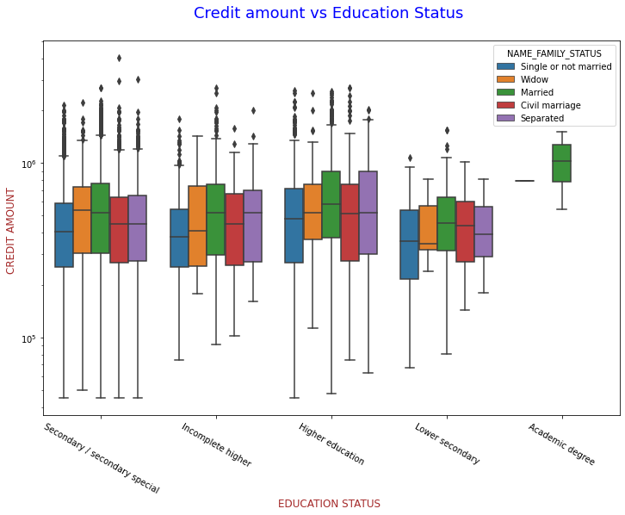
Inference 1.11
Observations are Quite similar with Target0
Family status of 'civil marriage', 'marriage' and 'separated' of Academic degree education are having less number of credits than others.
Most of the outliers are from Education type 'Higher education' and 'Secondary'.
Most number of all types of education as well as family lie in lower bound

Slide 12
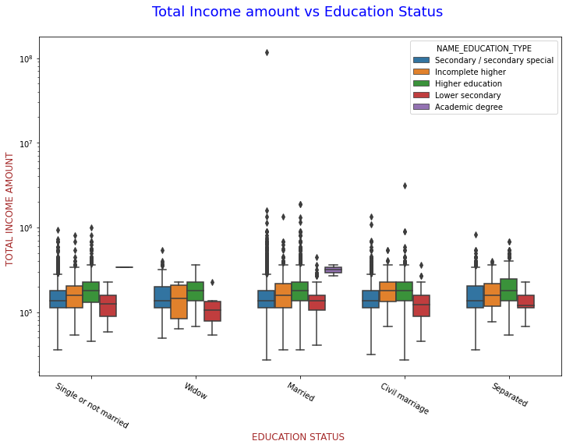
Inference 1.12
This is also having some similarity with target0,
Almost all Family types and education types have the income amount mostly equal.
Least outlies are for Lower secondary and their income amount is also little lesser than that of all other education types.
Academic degree are very less number of people in payments with difficult data frame named target1

Slide 13
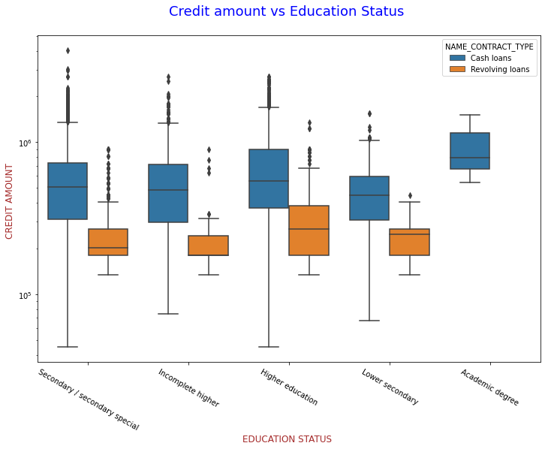
Inference 1.13
Its similar to that of inference 1.10
Even though people have difficulties with payments, loan application are still pouring in with similar credit amount demands from the clients

Slide 14
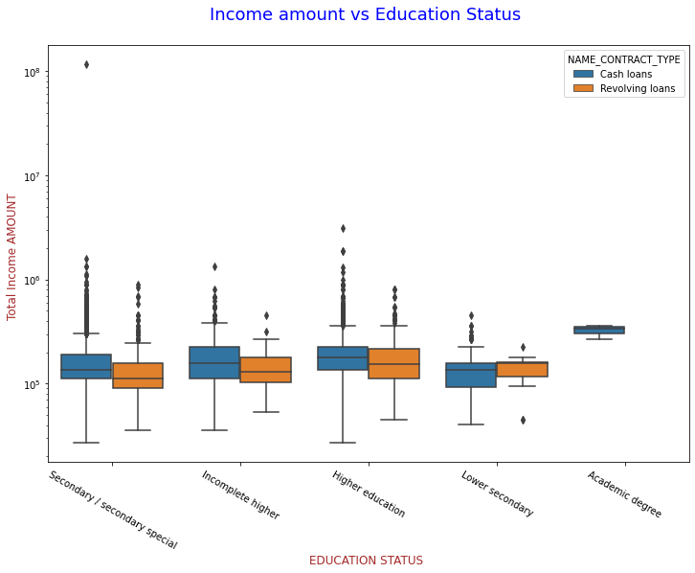
Inference 1.14
It can be seen that the maximum income amount holders are with education levels secondary and higher education levels
Its strange that, there are no revolving amount loans are demanded by clients with education level academic degree

Slide 15
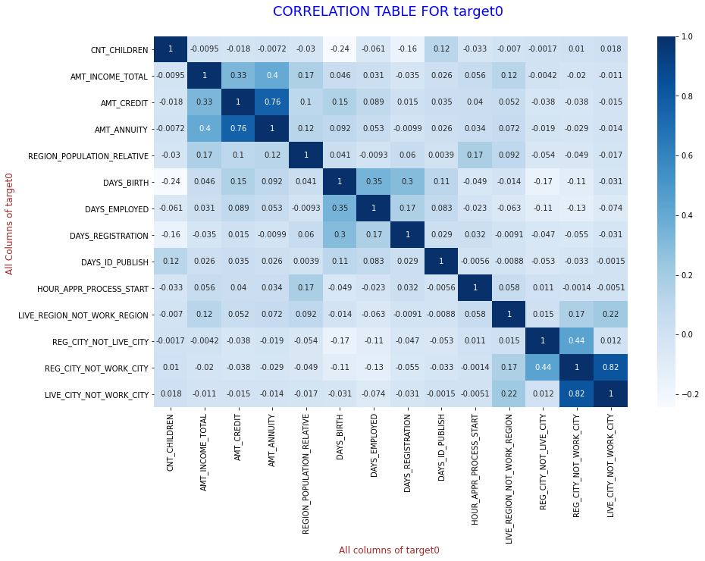
Multivariate Analysis on Application dataset
Inference 1.15
MOST RELEVANT CORRELATIONAL PAIRS with no difficulties of payment
It is observed that the maximum correlation is between the variables listed below in pairs
AMT_CREDIT to AMT_ANNUITY
AMT_CREDIT to AMT_TOTAL_INCOME
AMT_ANNUITY to AMT_INCOME_TOTAL
REG_CITY_NOT_WORK_CITY to REG_CITY_NOT_LIVE_CITY
DAYS_EMPLOYED to DAYS_BIRTH
DAYS_BIRTH to DAYS_REGISTRATION
Least or negative correlation is between the variables listed below in pairs
DAYS_BIRTH to CNT_CHILDREN

Slide 16
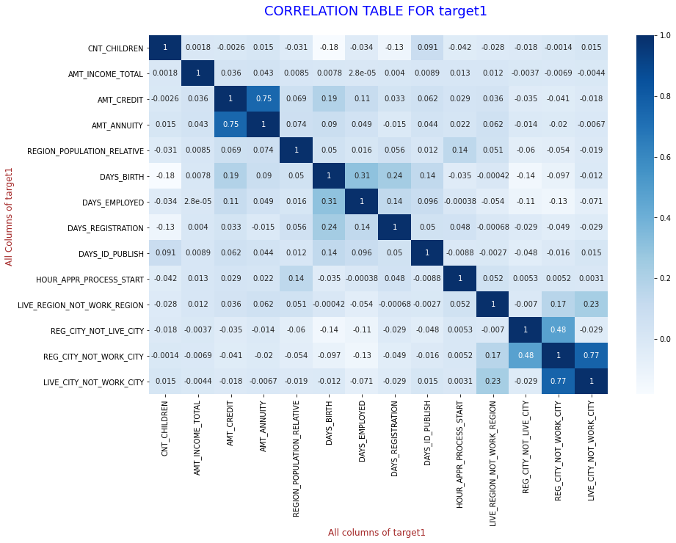
Inference 1.16
Almost all of the correlational pairs of variables are as same as in Inference 1.15

Slide 17
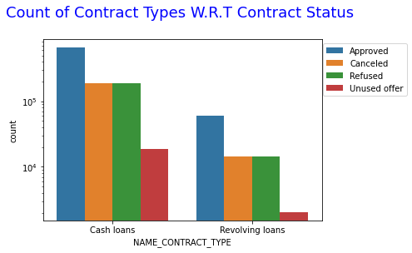
Univariate analysis on merged data frame
Inference 2.1
Contract type cash loans are maximum in number where all kinds of contract statuses are more than contract type revolving loans

Slide 18
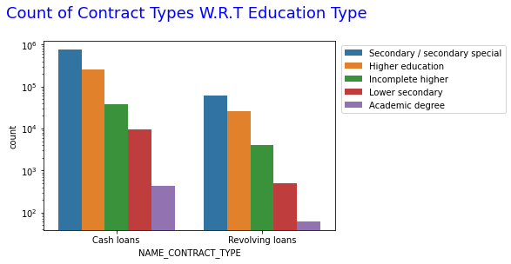
Inference 2.2
Most clients with all kinds of education types apply mostly for cash loans rather than revolving loans

Slide 19
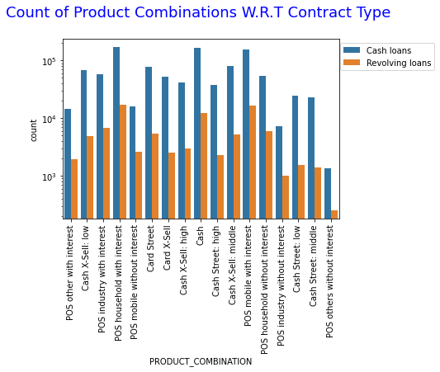
Inference 2.4
Maximum number of contract types are of Product combination of POS household with interest followed by Cash and then followed by POS mobile with interest
Least number of clients opt for product combination of POS others without interest

Slide 20
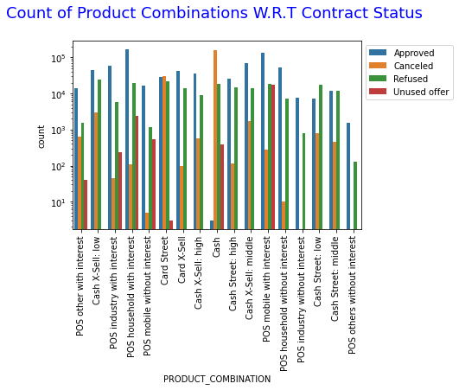
Inference 2.5
Most canceled loans are of the product combination, Cash.
Most refused loans are of product combination Cash X-Sell: low
There are almost nil unused offers in product combinations listed below
Cash X-Sell: low
Card X-Sell
Card X-Sell: high
Cash Street: high
POS household with interest
Cash Street: middle
Cash X-Sell: middle
Cash Street: low
Some product combinations are nil incase of unused offers as well as cancelled loans
POS industry without interest
POS others without interest

Slide 21
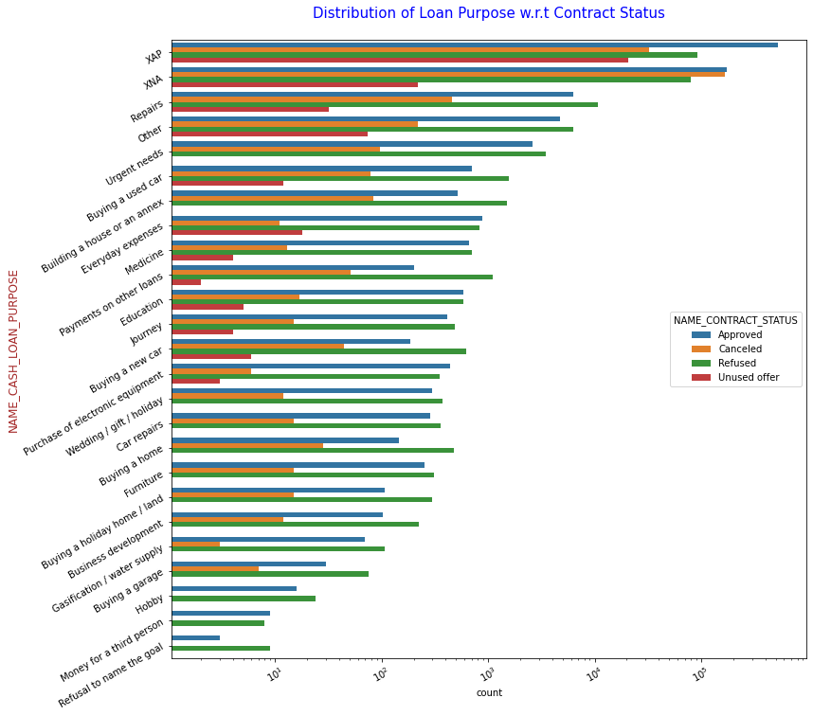
Inference 2.6
Most rejection of loans came from purpose 'repairs'.
For education purposes we have equal number of approves
Rejection for Paying other loans and buying a new car are having significant higher rejection than approves.

Slide 22
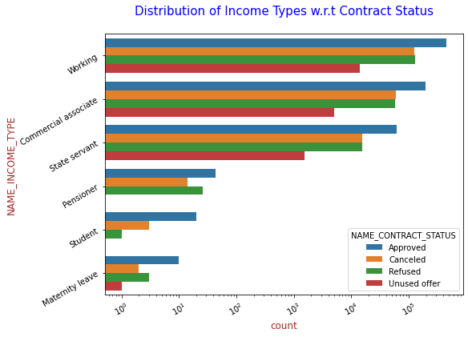
Inference 2.7
There are no unused offers for students and pensioners
The number of approved loans for state servants is almost equal to the refusal or canceled loans for Commercial associates
Maximum unused offers is by working clients

Slide 23
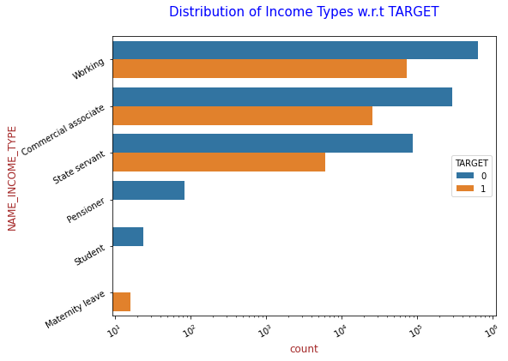
Inference 2.8
There are no clients with payment difficulties who are students and pensioners
There are no clients on maternity leave with no payment difficulties

Slide 24
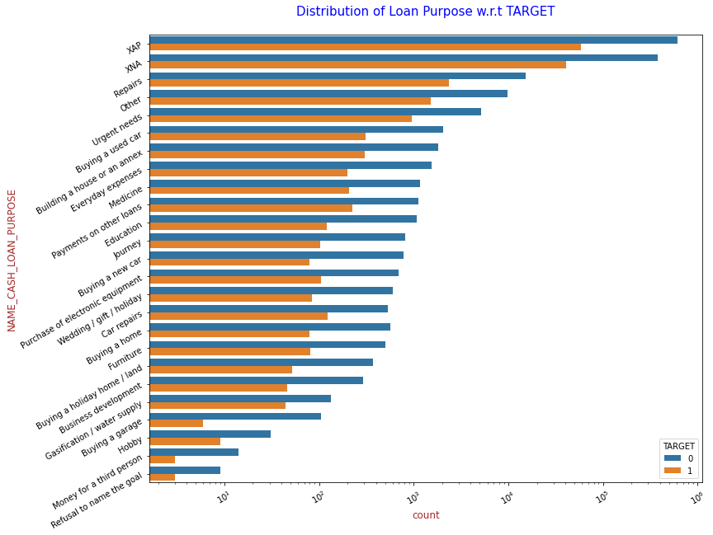
Inference 2.9
Loan purposes with 'Repairs' are facing more difficulties in payment.
There are few places where loan payment is significantly higher than facing difficulties. They are 'Buying a garage', 'Business development', 'Buying land', 'Buying a new car' and 'Education'.
Hence we can focus on these purposes for which the client is having minimal payment difficulties.

Slide 25
Inference 2.10 is for the plot in next slide
The credit amount of Loan purposes like 'Buying a home', 'Buying a land', 'Buying a new car' and 'Building a house' is higher being a 'commercial associate' and even in general irrespective of income type.
Income type of state servants having no amount of credit applied for purpose of Money for third person or a Hobby.
Most of the commercial associates have refused to provide purpose of credit

Slide 26
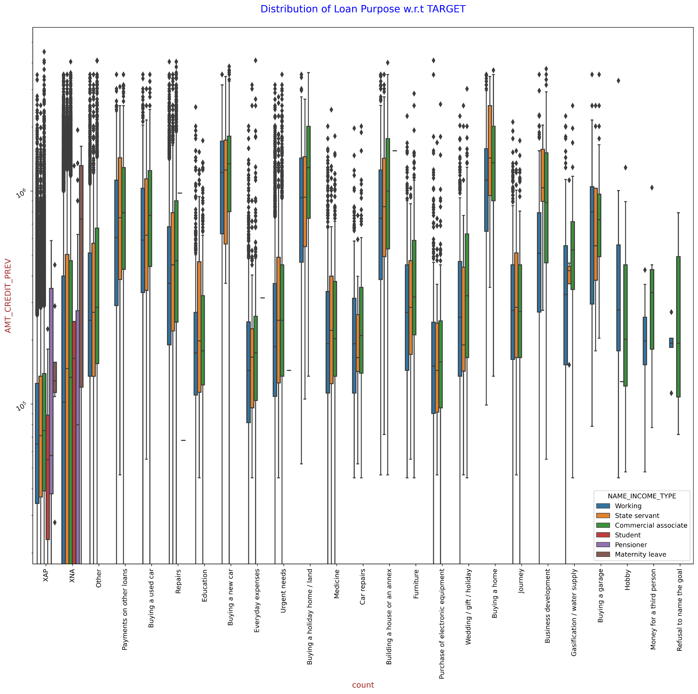

Slide 27
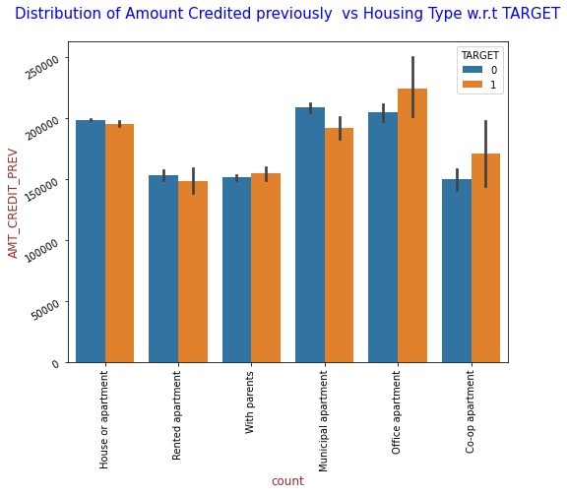
Inference 2.11
Here for Housing type, office apartment and co-op apartment are having higher credit of target 1.
So, we can conclude that bank should avoid giving loans to the housing type of office apartment and co-op apartment as they are having difficulties in payment.
Bank can focus mostly on housing type with parents or House or apartment or municipal apartment for successful payments.

Slide 28
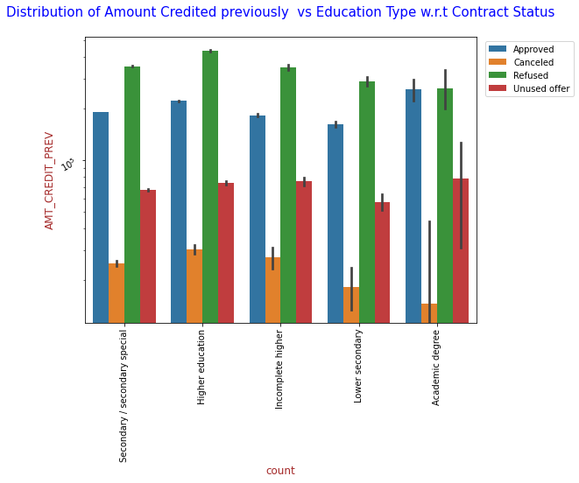
Inference 2.12
It can be seen that number of refusals are for clients has nothing to do with their education levels
Almost all education level clients have equal unused offers.

Slide 29
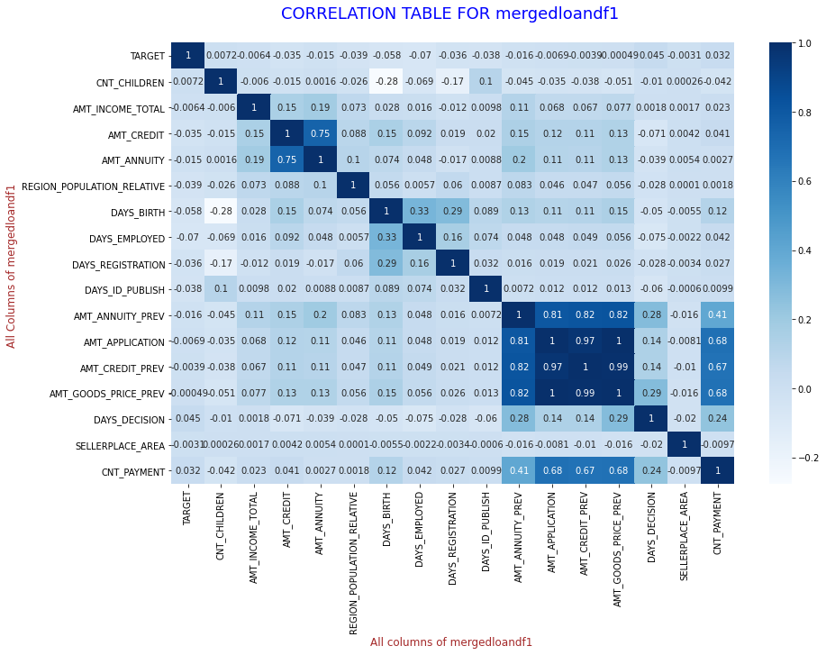
Inference of Multivariate Analysis of merged data frame
We can observe correlations of different variables plotted in the above graph and draw almost similar inference as we drew in Inference 1.15, with few extra variables

Slide 30
Final Inference
Banks should focus more on contract type ‘Student’ ,’pensioner’ and ‘Businessman’ with housing ‘type other than ‘Co-op apartment’ and 'office apartment' for successful payments.
Banks should focus less on income types maternity leave and working as they have most number of unsuccessful payments
In loan purpose ‘Repairs’:
Although having higher number of rejection in loan purposes with 'Repairs' we can observe difficulties in payment.
There are few places where loan payment difficulty is significantly high.
Bank should continue to be cautious while giving loan for this purpose.
Bank can focus mostly on housing type with parents , House or apartment and municipal apartment with purpose of education, buying land, buying a garage, purchase of electronic equipment and some other purposes with target0 significantly more than target1 for successful payments.
Banks can offer more offers to clients who are students and pensioners as they take all offers and are more likely to pay back

